Slide 1
DATA 621: BUSINESS ANALYTICS AND DATA MINING FINAL PROJECT Presentation Group 2 - Gabriel Campos, Melissa Bowman, Alexander Khaykin, & Jennifer Abinette

Slide 2
Project analysis slide 2
Project Analysis
SPECIFICATION
MODEL
FINAL PROJECT
INSPECT
Conclusions
CLEAN | CONFIGURE
[can be
removed if not used]

Slide 3




Project analysis slide 3
Specifications
Data Source
Planning
Requirements
Analysis
Reporting
Anti-Defamation
League (ADL)
Format: .csv
Using the data from hate_crime.csv, create a regression model for predicting future anti-semitic crime likelihood
Data Import
Cleansing
Transformation
Train/Test samples
Models

Slide 4
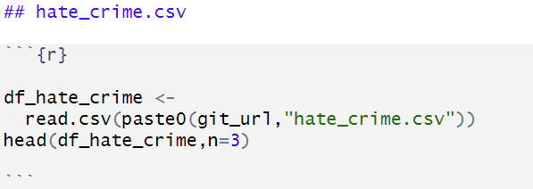
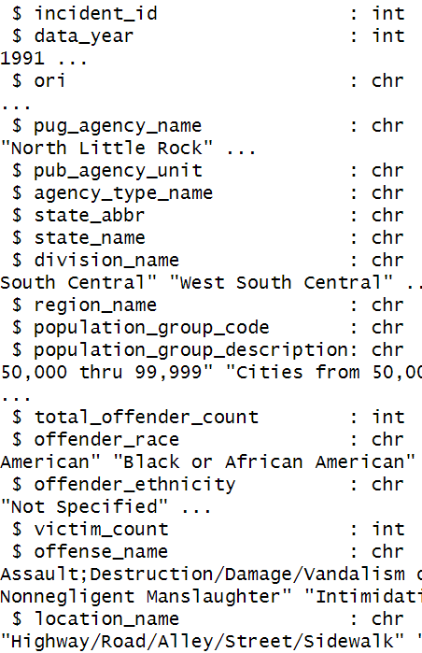
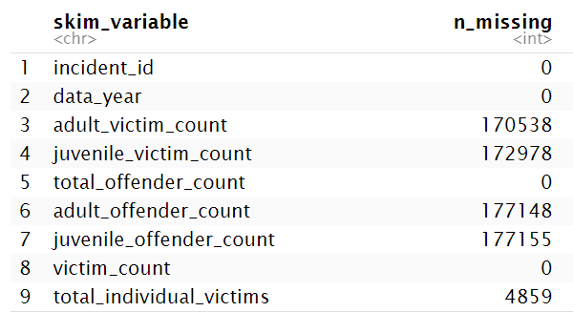
Project analysis slide 4
Inspect
Data was imported from hate_crime.csv sourced from ADL website
Many columns from data source are categorical data
5 columns are noted as having a high number of missing values

Slide 5
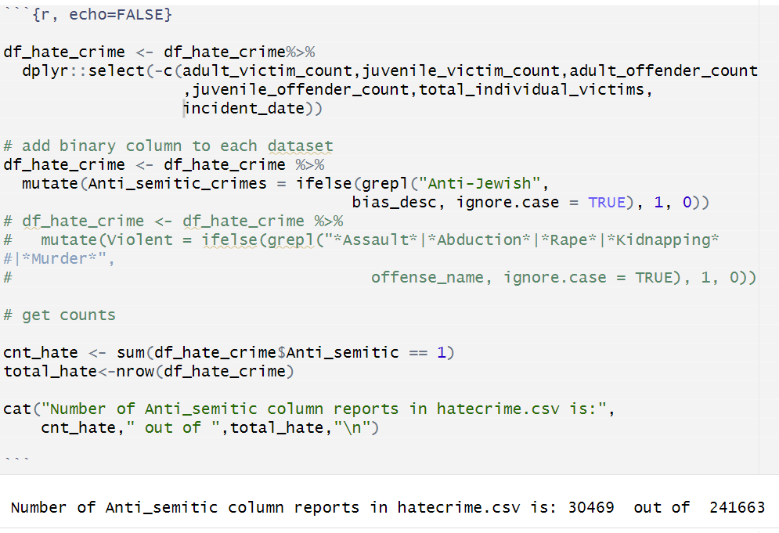
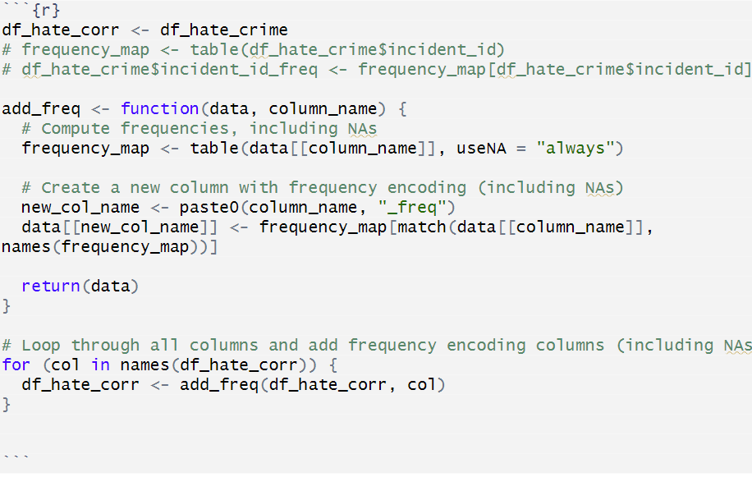
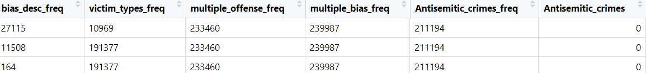
Project analysis slide 5
Clean |Configure
Categorical data point frequencies were used to replace existing categorical values & Binary Column ‘Antisemitic_crimes’ was added to differentiate non antisemitic and antisemitic crimes, then stored to df_hate_corr

Slide 6
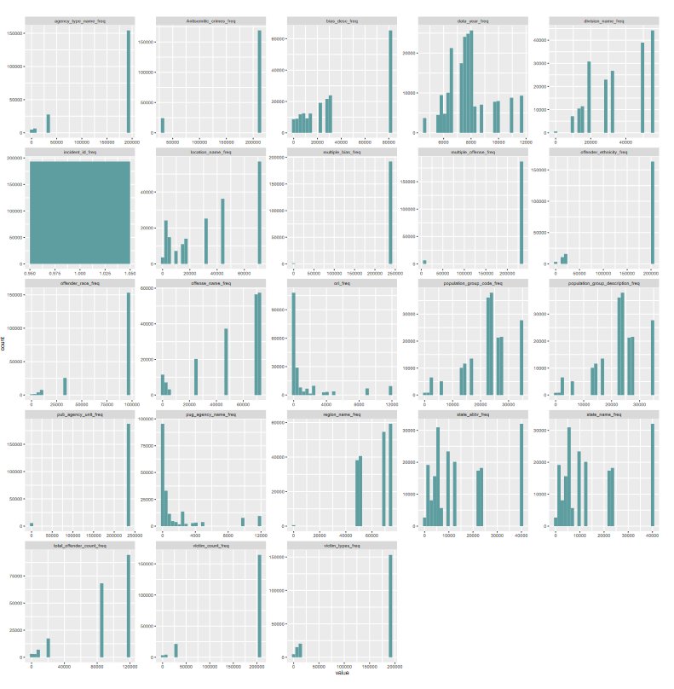
Project analysis slide 6
Clean |Configure
(cont’d)
The Train/Test datasets were drafted using
a 80/20 partition.
Visually we see many attributes lacking any
level of normalization.

Slide 7
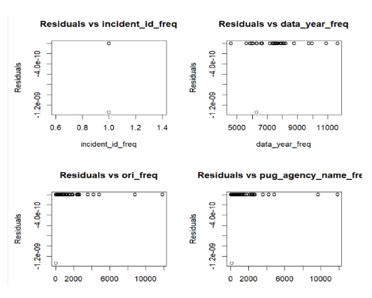
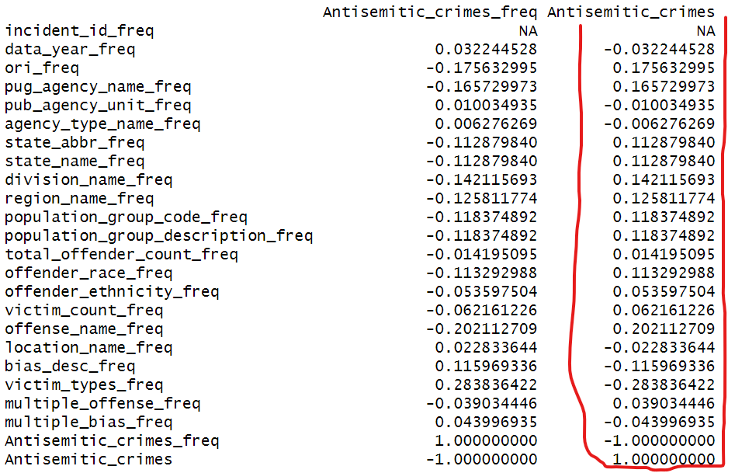
Project analysis slide 7
Clean | Configure
(cont’d)
The correlation values for Antisemitic_crimes show low correlation after the transformation for most columns
Our plots when inspecting for weighted values showed visually showed a lack of heteroskedasticity, due to lacking a ‘fan-like’ or ‘cone-shaped’ pattern.
Obtaining the weighted values was not pursued

Slide 8
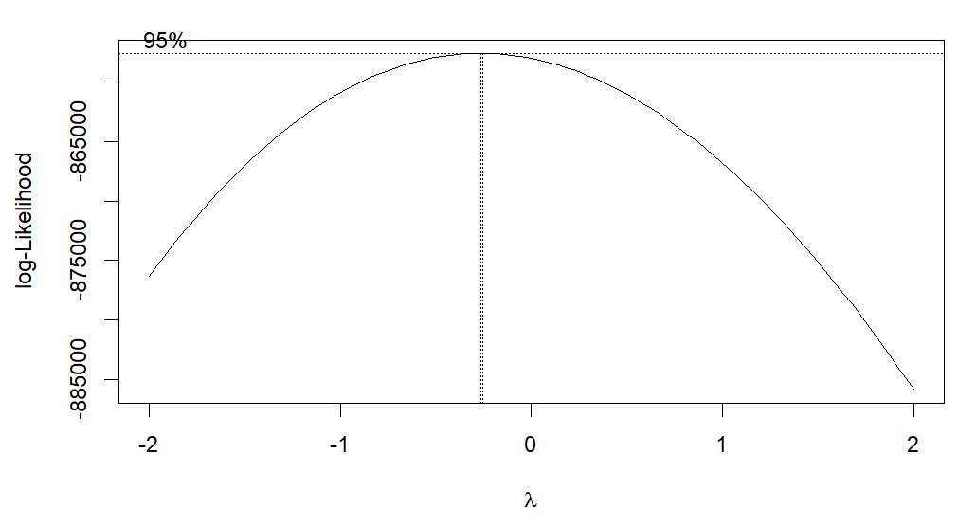
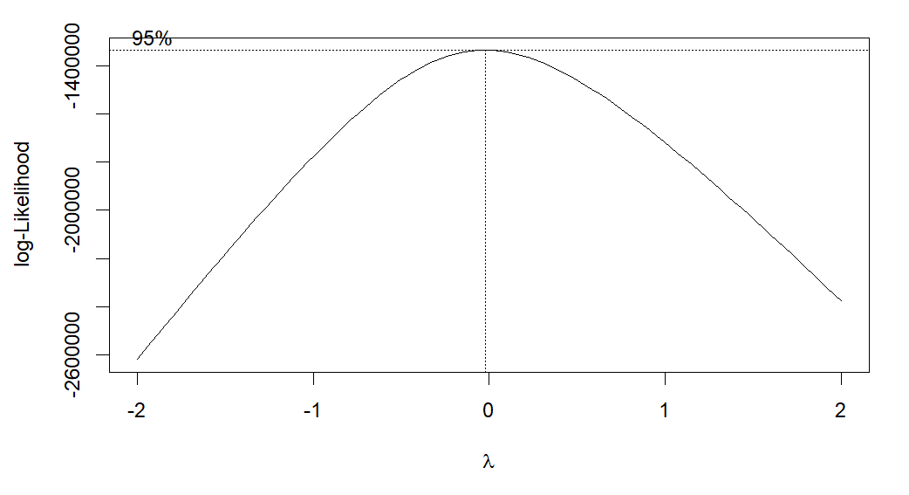
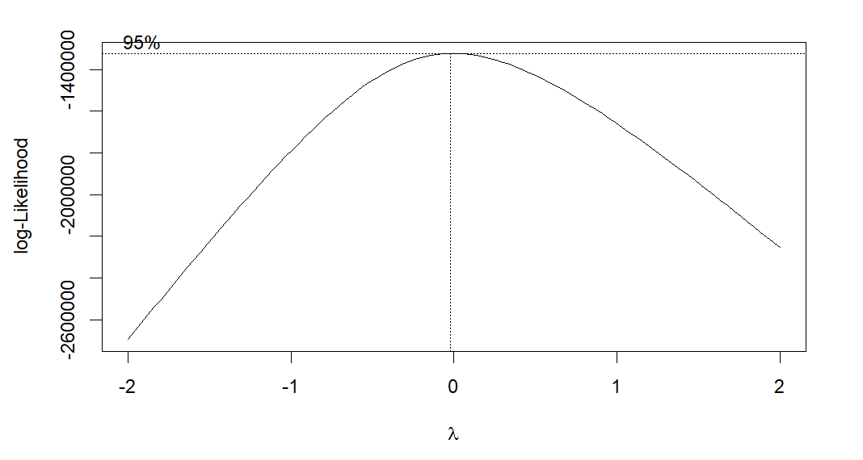
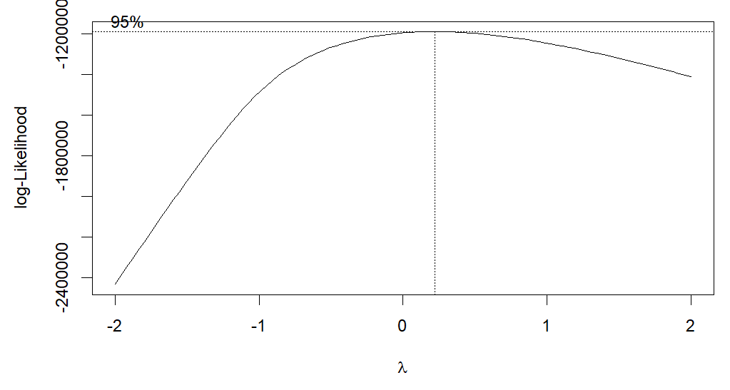
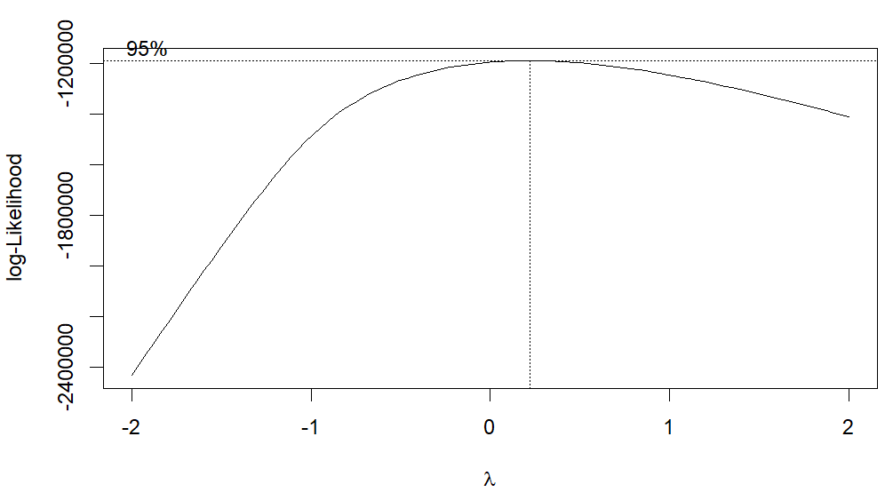
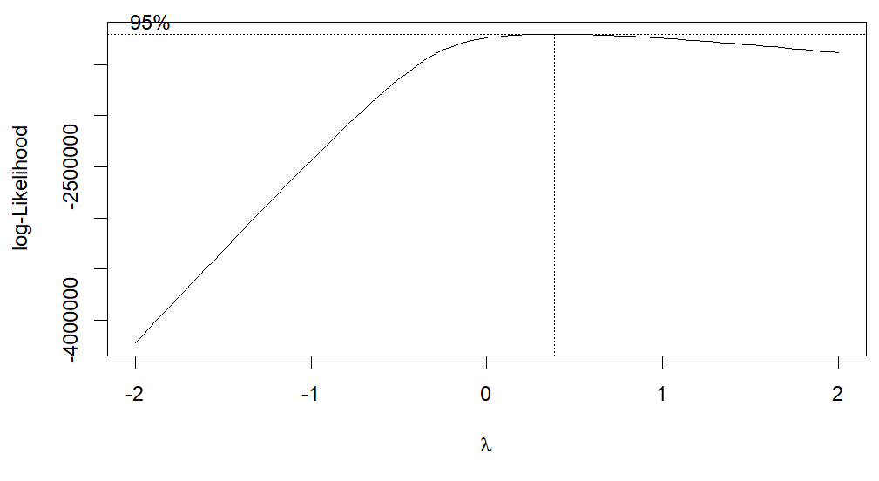
Project analysis slide 8
Clean | Configure
(cont’d)
The below attribute were chosen to utilize the Box-Cox transformation after the excluded variable were identified as incompatible. The Values were appended to the Train and Test dataset.
data_year_freq
ori_freq
pug_agency_name_freq
state_abbr_freq
state_name_freq
bias_desc_freq

Slide 9
Project analysis slide 10
Model

Slide 10
Thank You

